Slide 1
Identity Federation
WSO2 Identity Server Fundamentals

Slide 2
Why Identity Federation?
Consumers: To access applications with minimum effort
Enterprises:
  To adopt new business demands, fast
  To adhere to complex corporate requirements,
    Password policies
    Strong authentication
    Login policies
    Regulatory compliance

Slide 3
What is Identity Federation?
Connecting a person's digital identity and attributes
stored across multiple distinct trust domains.

Slide 4










Application Ecosystem
Authenticating users existing in an external identity provider
HR Application
Userstore
Accounts Application
Application User
[John Doe]
Identity Provider
External
Identity Provider
WSO2 Identity Server
Sales Application

Slide 5
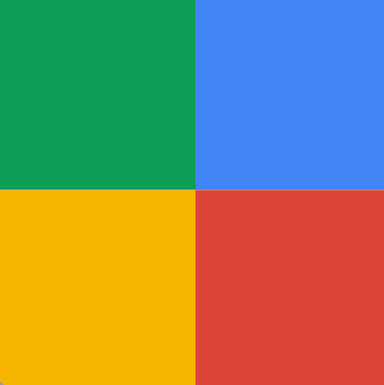
Identity Federation with Social Login
Authenticating users using a social service provider as an external IdP
Facebook
HR Application
WSO2 Identity Server
Google
Accounts Application
Application User
[John Doe]
Identity Provider
External
Identity Provider
WSO2 Identity Server
Sales Application

Slide 6
Benefits of Using Identity Federation
Security
  Open standards
  Single sign-on
  Multi-factor authentication
Cost
  Standardized access control policies
  Minimize time and effort for regulatory compliance and to adopt latest security trends

Slide 7
Quick Recap

Slide 8

Why identity federation?
About identity federation and identity federation with social login
Benefits of identity federation
What you learnt

Slide 9



Any Questions ?
Reach us through the following channels
iam-dev@wso2.org
https://stackoverflow.com/questions/tagged/wso2-identity-server
https://discord.com/invite/Xa5VubmThw

Slide 10
Thank you!
Notes:
Acknowledge that it’s been a lot of changes within the team
Thank you for your taking onboard the feedback and being open to change.
A lot of work , a lot of learning, sometimes feeling twice the exhaustion
But also hopefully seeing what I see, which is: better ways of working, more innovation in our approach, more business acumen, more effective reactivity , more ahead of the game. Because that’s where marketing needs to be.
All this in a context where it’s also been a lot of changes for WSO2.
And from this standpoint I wanted to remind you of what Sanjiva said about you owning the culture

